Slide 1

PREDICTING CREDIT RISK
Professor
Mr. Syed Jawad Shah
Insight Seekers
Akhila Reddyrajula
Aishwarya Musuku
Satya Sai Pramod Burgula
Akshay Kumar R

Slide 2
Introduction
Credit risk prediction is a critical task in the financial sector. Lending institutions heavily rely on machine learning algorithms to assess the creditworthiness of clients.
This project aims to develop a robust model for predicting credit risks based on various client attributes such as income, loan size, loan status, and more.

Slide 3
Content
Model creation
Data discovery
Preprocessing
Model selection
Training and Evaluation
Data Analysis
Future enhancements

Slide 4
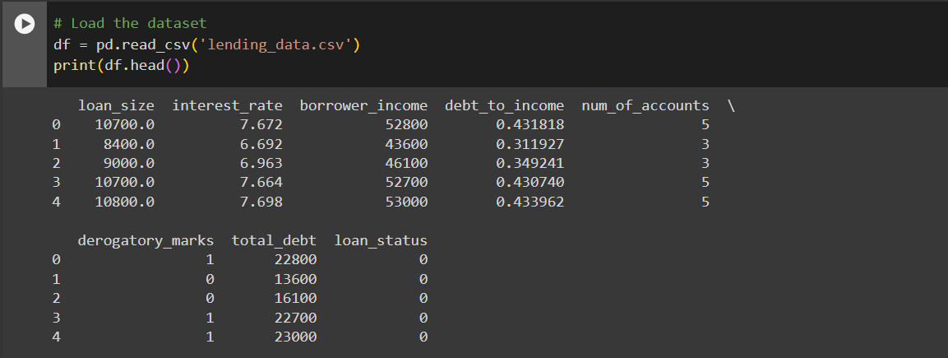
Model Creation: Data Discovery
Loading the dataset (df = pd.read_csv('lending_data.csv')).
Checking if the 'loan_status' column is present in the DataFrame.
df.columns returns a list of all column names in the DataFrame

Slide 5
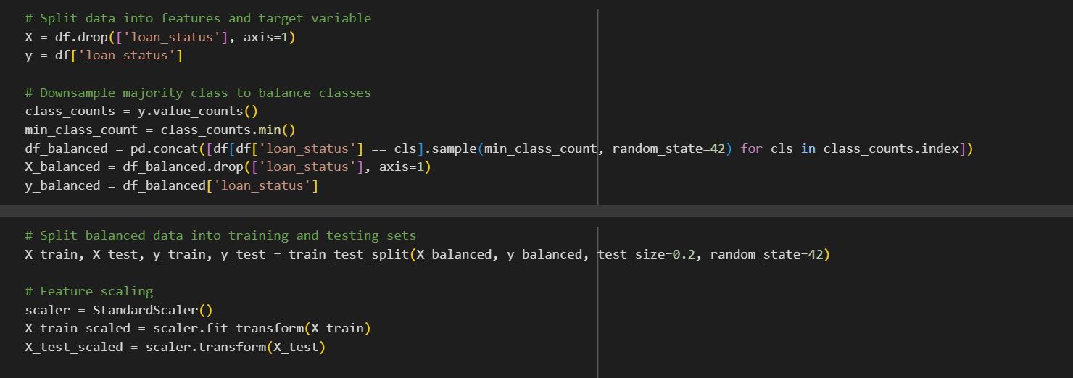
Model Creation: Preprocessing
Handling missing values by filling them with the median (df['borrower_income'].fillna(median_income, inplace=True)).
Splitting the data into features and target variable (X = df.drop(['loan_status'], axis=1) and y = df['loan_status']).
Balancing the classes by downsampling the majority class.
Splitting the balanced data into training and testing sets (train_test_split()).
Feature scaling using StandardScaler().

Slide 6
Model Creation: Model Selection
The Random Forest Classifier is an ensemble learning method based on decision trees. It works by constructing a multitude of decision trees during training and outputs the class that is the mode of the classes (classification) or mean prediction (regression) of the individual trees.
Logistic Regression is a simple linear classification algorithm that predicts the probability that a given instance belongs to a particular class. Despite its name, it's used for classification rather than regression.
WHY??
These models were likely chosen due to their simplicity, interpretability, and effectiveness in handling binary classification tasks like credit risk prediction.
Random Forest Classifier is a powerful ensemble method known for its robustness and ability to capture complex relationships in the data without much feature engineering.
Logistic Regression, on the other hand, serves as a baseline model due to its simplicity and ease of interpretation. It's often used to establish a benchmark performance before trying more complex models.

Slide 7
Model Creation: Training and Evaluation
Training the models using the training data (model.fit(X_train_scaled, y_train)).
The classification report provides a detailed evaluation of the model's performance, including metrics such as precision, recall.
The confusion matrix gives a summary of the model's predictions, showing the number of true positives, true negatives, false positives, and false negatives, providing insights into the model's performance across different classes.
The ROC curve help evaluate the model's ability to discriminate between positive and negative classes by plotting the true positive rate against the false positive rate, providing a visual representation of the model's performance across different thresholds.

Slide 8
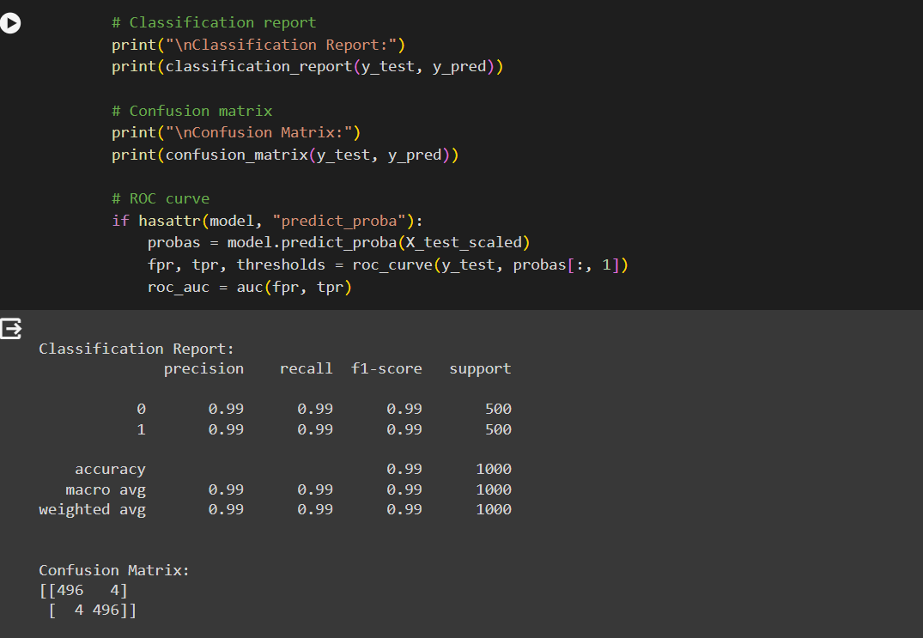

Slide 9
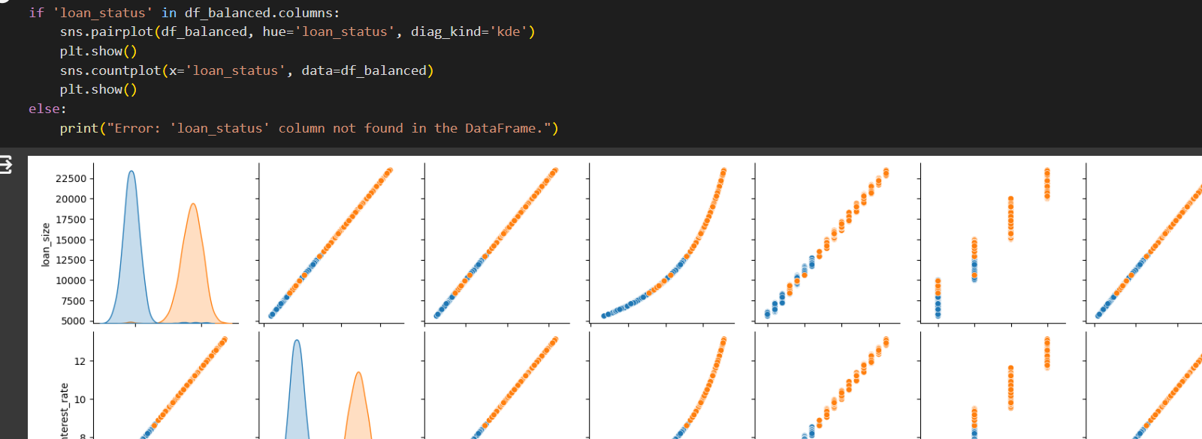
Model Creation: Data Analysis
Data visualization using pairplot and countplot (sns.pairplot() and sns.countplot()).
The sns.pairplot() function is used to visualize pairwise relationships in the dataset, particularly between numerical variables, with the hue parameter representing the loan status, aiding in understanding the data distribution and potential correlations.
The sns.countplot() function is employed to display the distribution of loan statuses, offering insights into class balance and potential class imbalances within the dataset.

Slide 10
Future Enhancements
Model Ensembling: Explore techniques such as model stacking or blending to combine predictions from multiple models. This can potentially improve predictive performance by leveraging the strengths of different algorithms.
Hyperparameter Tuning: By implementing more sophisticated hyperparameter tuning techniques such as grid search or randomized search to optimize model performance. Tuning the parameters of your models can lead to better accuracy and generalization.
Advanced Feature Engineering: Investigate more advanced feature engineering techniques such as polynomial features, interaction terms, or domain-specific transformations. These techniques can help uncover complex relationships between variables and improve model performance.
Utilize Additional Data Sources: Incorporate additional data sources such as macroeconomic indicators, industry-specific trends, or alternative credit data to enrich the feature set and enhance predictive power.
Anomaly Detection: Integrate anomaly detection techniques to identify unusual patterns or outliers in the data that may indicate fraudulent behavior or credit risk. This can help improve the model's ability to detect high-risk loans.

Slide 11
Thank You!

